Slide 2
Outline
Review
Marr’s levels
Problem set 0 review
Formal Languages & the Chomsky Hierarchy
Turing Machine
Notes:
First ask how many kids went to other sections last week

Slide 3
Marr’s 3 Levels of Analysis

Slide 4
Check Your Understanding
Which level(s) of analysis do the following questions address?
Can we build a logical AND gate using Legos?
How do people identify and retrieve information from long-term memory?
What is the optimal strategy for playing Rock-Paper-Scissors?
What techniques do firefighters use to predict where a fire will spread?
Notes:
Implementational
Algorithmic/Implementational (ambiguous)
Computational
Algorithmic

Slide 5
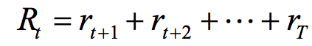
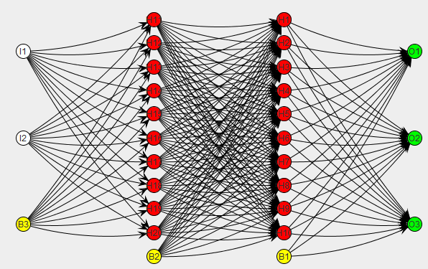
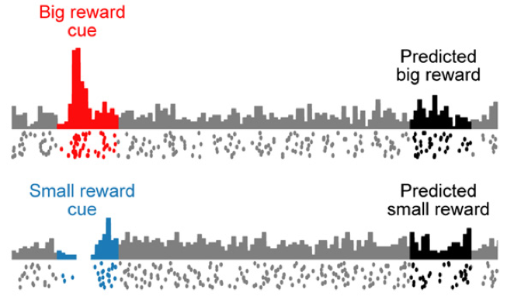
Three Levels of Description
Computational Why do things work the way they do? What is the goal of the computation? What are the unifying principles?
maximize:
Algorithmic What representations can implement such computations? How does the choice of representations determine the algorithm?
Implementational How can such a system be built in hardware? How can neurons carry out the computations?
Modified from slide by C. Rothkopf: http://fias.uni-frankfurt.de/~rothkopf/docs/david_marr_3_levels.jpg

Slide 6
A Loose Hierarchy
Marr’s levels of analysis are coupled, but only loosely: often an explanation at one level involves issues that are mostly independent of the other two!
Examples:
Does knowing why a cash register exists tell us anything about the how it performs its computations?
Will knowing the state of every neuron in the brain automatically tell us what the brain is computing?

Slide 7
How Universal Are Marr’s Levels?
Question: Does every information processing task have an explanation at each of Marr’s 3 levels?
Answer: Not necessarily! Some phenomena may have explanations at only one or two levels of analysis.
Examples:
Afterimages
Auditory masking

Slide 8
An Approach to Computational Analysis
Map inputs to outputs
What regularities do you see?
Can they be characterized using mathematics?
Use knowledge of these regularities to develop a theory of the problem(s) the system is solving
Potential Pitfall: Phenomena that lack a function won't have a meaningful computational level description!
Work out an optimal solution to the problem you’ve identified
Perform experiments to see how well the system’s behavior corresponds to your solution

Slide 9
PS0 review

Slide 10
Matrix indexing
matrix = np.zeros([len(x), len(y)])
for i in range(len(x)):
for j in range(len(y)):
matrix[i, j] = my_func(x[i], y[j])

Slide 11
Language as formal system

Slide 12
How complex is natural language?
How complex is natural language and how do we even measure that?
We need to hone in on what language really is
Language as a set of prebuilt sentences?
Notes:
Linguists have been concerned with characterizing complexity of natural languages since a long time - better understand the blueprints of natural language and what its different components really are – also a case for understanding language evolution
While all languages have various differences – they can all pretty much express highly complicated ideas. So we need to understand language all together.

Slide 13
Complexity of language
No upper limit on how many sentences there are or even how long they can be.
John thinks that
Alan thinks that
John should be allowed to work at Dolores Park

Slide 14
Language as a formal system
Instead, language can be thought of consisting of a set of rules that can we tap into to produce any type of sentences we like.

Slide 15
Language as a Formal System
Language: “A set (finite or infinite) of sentences, each finite in length and constructed out of a finite set of elements.”
This is a good sentence 1
Sentence bad this is 0
L
all possible sentences
Grammar: “…A device that enumerates [all the well-formed] sentences of a language [and no others].”

Slide 16
Formal Grammars
Formal Grammar: A finite set of rules of the form A -> B where A and B are sequences of symbols from the following classes:
A finite set of nonterminal symbols (can be modified)
A finite set of terminal symbols (cannot be modified)
A start symbol (a special nonterminal)
A formal grammar defines (or generates) a particular formal language.
Upshot: We can characterize formal languages in terms of the formal grammar(s) necessary to produce them.

Slide 17
Chomsky Hierarchy
Notes:
But how complex the rules have to be to fully capture human language?

Slide 18
Chomsky Hierarchy
Ranking of different types of rules along with different types of languages they can generate
Type-0
.
.
Type-3
Notes:
Once we can fit the rules, we can fit any language into the Chomsky Hierarchy. So where does natural language fit?

Slide 19
Type 3: Regular/Finite-State Grammars
Grammars in which every rule is of the form
where A and B are single nonterminals
x is an arbitrary string of terminals
phrase -> word phrase
phrase -> word
If phrase
If you phrase
If you pass phrase
If you pass this class then you will graduate

Slide 20
Type 3: Regular/Finite-State Grammar
Maybe English is a regular language?
Rules are too simple
Maybe our grammar needs some kind of memory
X
If if you pass this class then you will graduate

Slide 21
Type 2: Context-Free Grammars
Grammars in which every rule is of the form
Where A is a nonterminal
φ is a nonempty string of terminals and nonterminals
phrase -> if phrase then phrase
phrase -> either parse or phrase
phrase -> word phrase
phrase -> word
Notes:
Many artificial languages and programming languages fit into this Type

Slide 22
Cross-serial dependencies
We help Hans paint the house
mer em Hans s huss halfed aastriiche
We Hans the house help paint
Swiss-German allows verbs and their arguments to be ordered cross-serially!
Context-free grammars cannot produce languages with cross-serial dependencies

Slide 23
Type 1: Context-sensitive grammar
Grammars in which every rule is of the form:
where A is a nonterminal
σ and τ are arbitrary strings of terminals and nonterminals
φ is nonempty
Left-hand sides and right hand sides of any production (rewrite) rules may be surrounded by a context of terminal and nonterminal symbols.
[context] X [context] -> [context] Y [context]
Notes:
So most natural languages are at least mildly type 1
"if you see A in a given context, you may replace A by the string theta."

Slide 24
Type 0: Recursively Enumerable Grammars
No restrictions on rules: rules may be recursive, and any number of symbols may occur on either side of a rule

Slide 25
The Chomsky Hierarchy
We can measure the complexity of a formal language in terms of the complexity of the simplest machine which can recognize it
Grammar | Language | Machine
Unrestricted | Computable | Turing machine
Context sensitive | Context sensitive | Bounded Turing machine
Context free | Context free | Push-down automaton
Finite-state grammar | Regular | Finite state automaton
(Natural languages)
Complexity
generates
is recognized by

Slide 26
What is a Turing machine?
Hypothetical machine that can simulate ANY computer algorithm, no matter how complicated it is!

Slide 27
Languages accepted by
Turing Machines
Context-Free Languages
Regular Languages

Slide 28
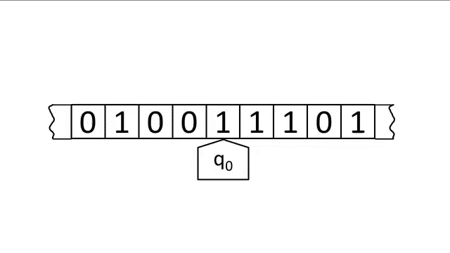
Turing Machine

Slide 29
A Turing Machine
Tape
......
......
Control Unit
Read-Write head
Notes:
Control unit is essentially the program which tells the Turing machine what to do

Slide 30
The Tape
No boundaries -- infinite length
Head at each time step:
Reads a symbol
Writes a symbol
Moves left or right
......
......
Read-Write head

Slide 31
Example 1
......
......
Time 1
......
......
Reads ‘a’
Writes ‘k’
Moves left

Slide 32
Example 2
Time 1
......
......
Time 2
......
......

Slide 33
State and transitions
Write
Read
Move Left

Slide 34
Halting
The machine halts in a state if there is no transition to follow.
......
......
No transition from q1 – Halt!

Slide 35
Halting
......
......
No possible transition from q1 and symbol c – Halt!

Slide 36
Accepting states
Accepting states have no outgoing transitions
The machine halts and accepts
Allowed
Not allowed

Slide 37
Acceptance
Accept Input string
If machine halts in an accept state
If machine halts in a non-accept state
or
If machine enters an infinite loop
Reject Input string

Slide 38
Turing machine demo
Turing machine demo notebook available under assignments tab!

Slide 39
Summary
Chomsky famously characterized language as formal system.
We can think of language like a set of rules that can come together to generate all of its sentences.
The Chomsky hierarchy provides a means for characterizing the complexity of a formal language.
Human language lands somewhere in the upper half, in terms of power and sophistication.

